Slide 1

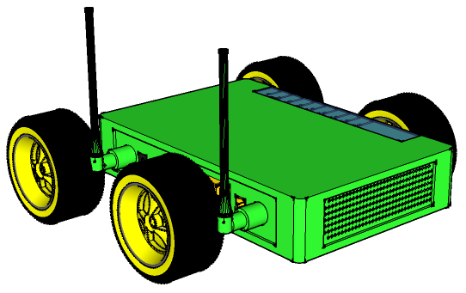




Infrastructure Mobility: A What-If Analysis
Mahanth Gowda
Nirupam Roy
Romit Roy Choudhury

Slide 2
Wireless Network Capacity
Revolutionary work in the last 30 years
Beamforming, MIMO, power-control, channel assignment, coding …
Capacity is reaching Shannon's limit, but the demand is still increasing

Slide 3
Wireless Network Capacity
Growing agreement in the community that we have reached saturation at the PHY Layer …
Next jump perhaps from new networking architectures.

Slide 4
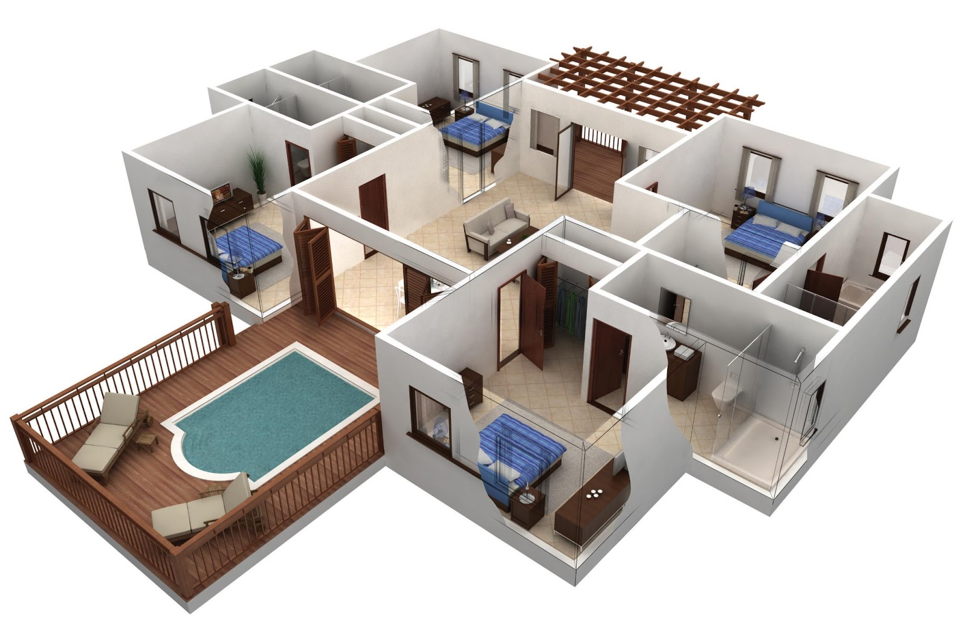

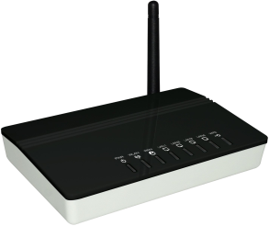
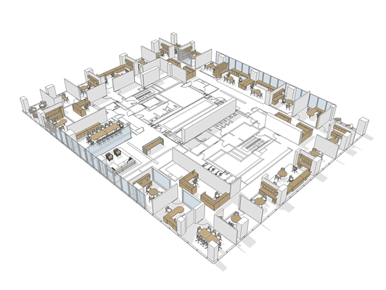
Static Infrastructure, Mobile Clients

Slide 5
What if Infrastructure is Mobile

Slide 6

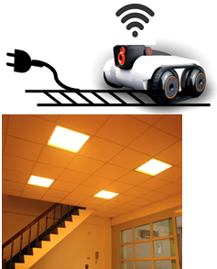
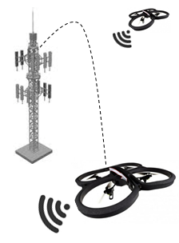



Regimes of Infrastructure Mobility
Tethered
Mobility (feet)
Ceiling Track
Mobility (meter)
Cell Tower Relays (km)
Mobility Range
Three main sources of gains

Slide 7
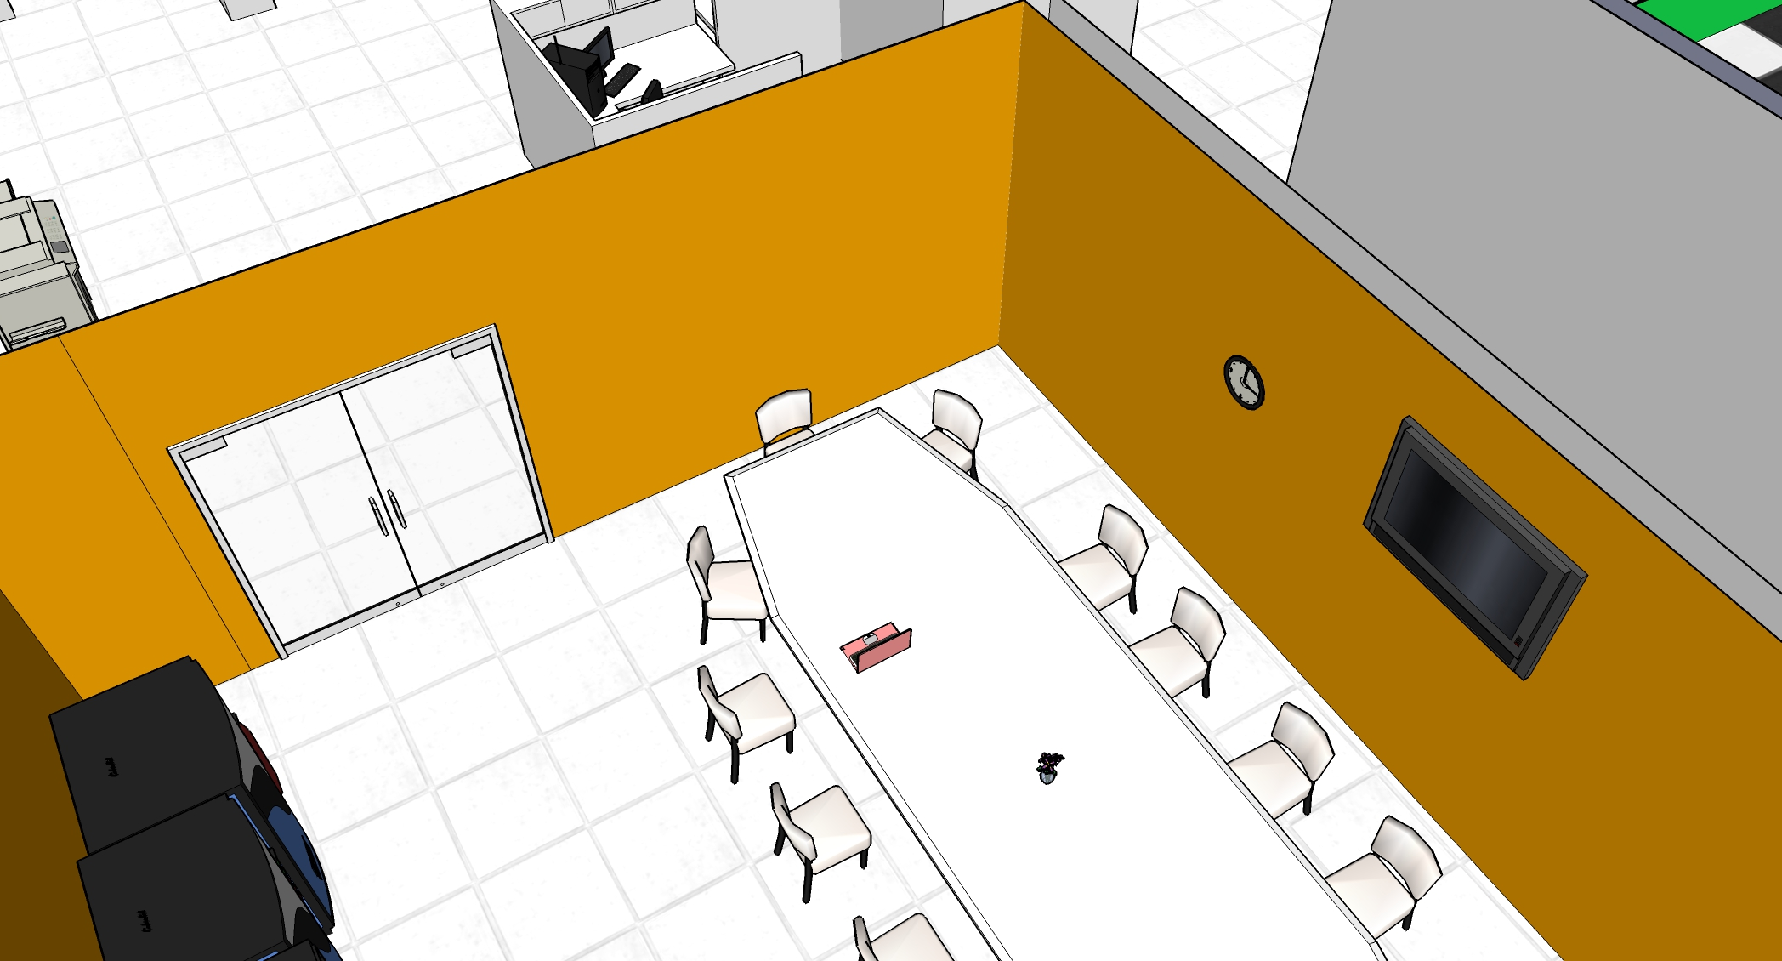
Indoor Multipath

Slide 8

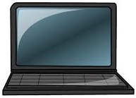
Multipath can Add up Destructively
Out of phase components
Destructive multipath – nullified signal

Slide 9
Small Mobility Facilitates Constructive Multipath
In Phase alignment with small AP motion
Constructive multipath – amplified signal

Slide 10
Shadowing
LoS Path blocked by wall

Slide 11
Shadowing
LoS opportunity by evading shadow

Slide 12
Regimes of Infrastructure Mobility
Tethered
Mobility (feet)
Ceiling Track
Mobility (meter)
Cell Tower Relays (km)
Mobility Range

Slide 13
Timescales
Channel
Variation
Traffic
Changes
User
Location
Topology
Faults
Time

Slide 14
1. What’s the Killer App?
Opportunities are many:
Better capacity
Localization
Improved energy
Security
Fault management
QoS, reliability, prioritization,
Software defined mobility … scalable
Not entirely sure about killer app
Treating this as a bottom-up research

Slide 15
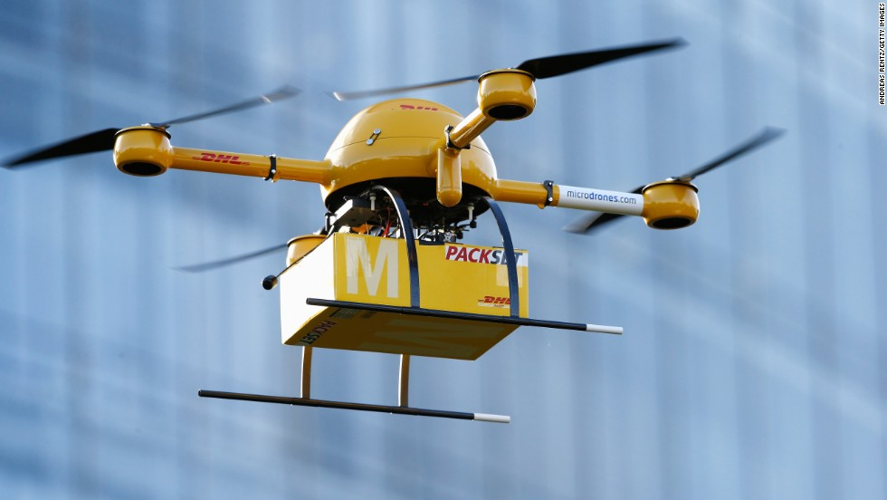

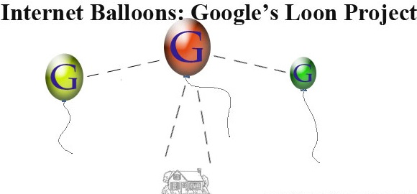

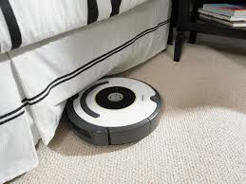
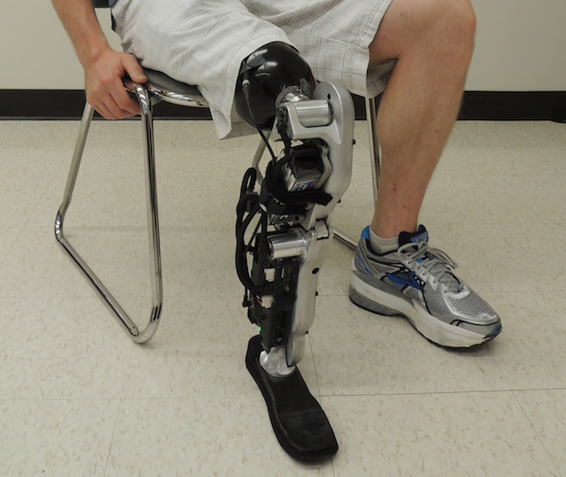
2. Is this Really Practical?
Robots permeating life … design, cost, reliability, safety not major issues
Package Delivery
Robotic Camera
Robotic Vacuum
Virtual Presence
Robotic Feet

Slide 16
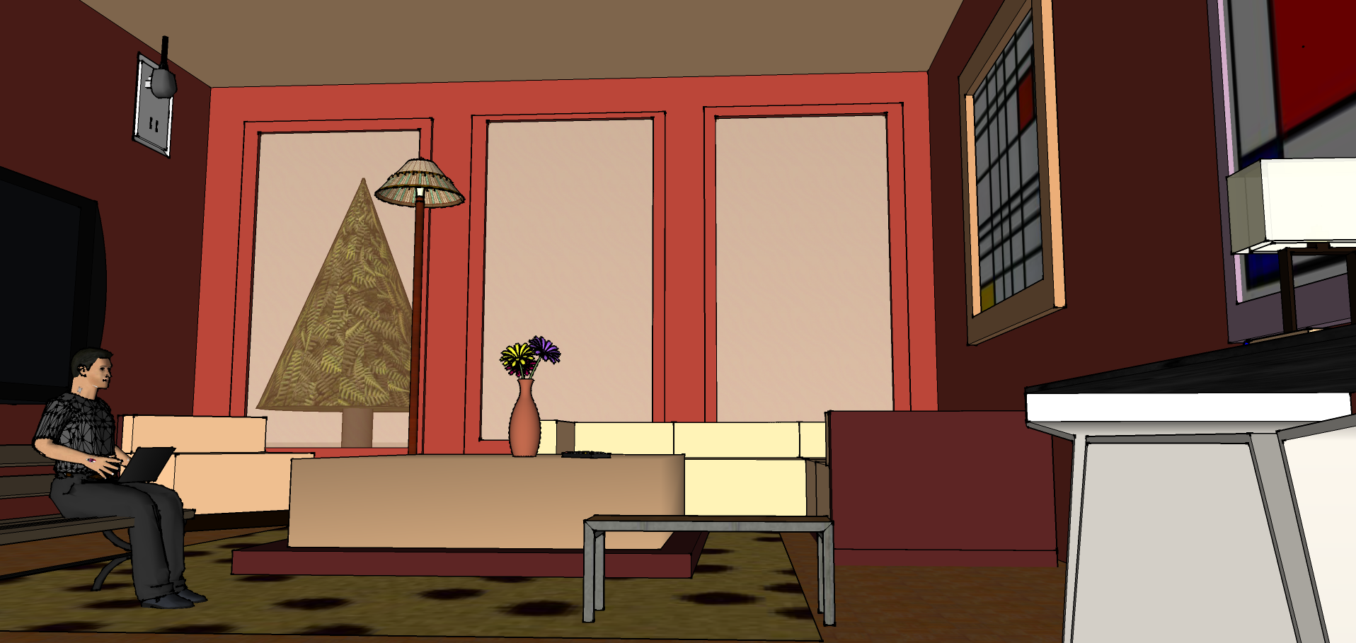
2. Is this Really Practical?
Today’s home

Slide 17



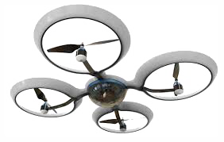
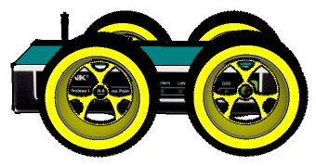
2. Is this Really Practical?
Smart homes!

Slide 18
3. How Compelling are the Gains?
Single-AP Mobility
Mobility can be only in small spatial scale (< 1 sq ft)
Exploit multipath opportunities
Constructive multipath - To increase signal strength of clients
Destructive multipath - To decrease interference from interferers
Upper bounds on throughput gain ~ 2x
Long Range Macro-mobility can offer upto 3x gains

Slide 19
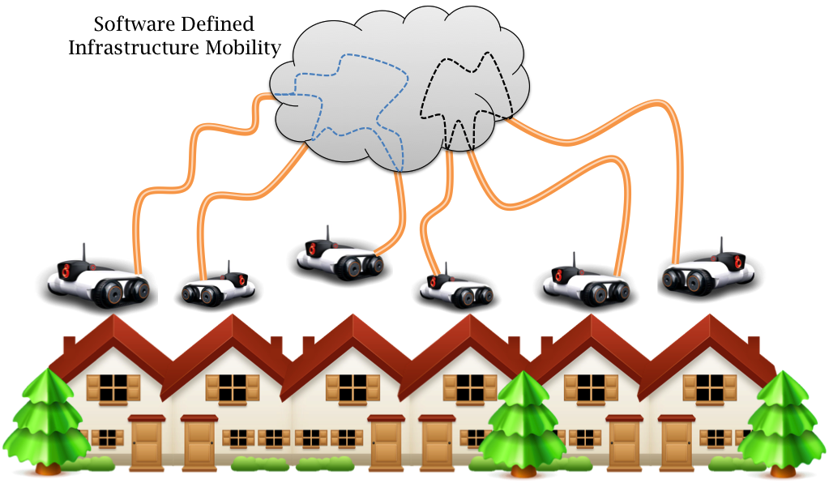
3. How Compelling are the Gains?
Multiple-AP Coordinated Mobility
Upto 1.8x gains (based on measurement driven simulations
Joint Mobility Control over Cloud

Slide 20
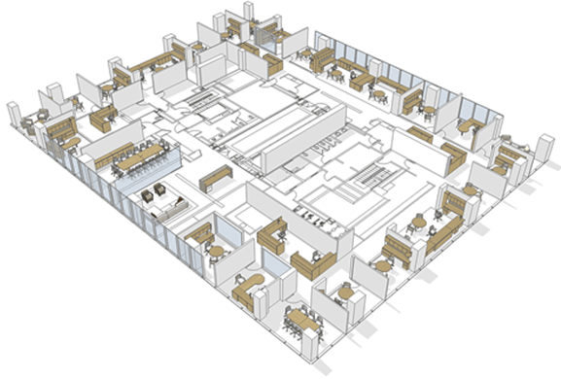
4. Why not Overprovision?
Yes, that’s possible.
However,
re-wiring + Ethernet costly
new protocols, eco-system
backward compatibility
Robotic WiFi APs can be plug and play → backward compatible
Moreover, multiple APs can together be mobile → additional gains

Slide 21
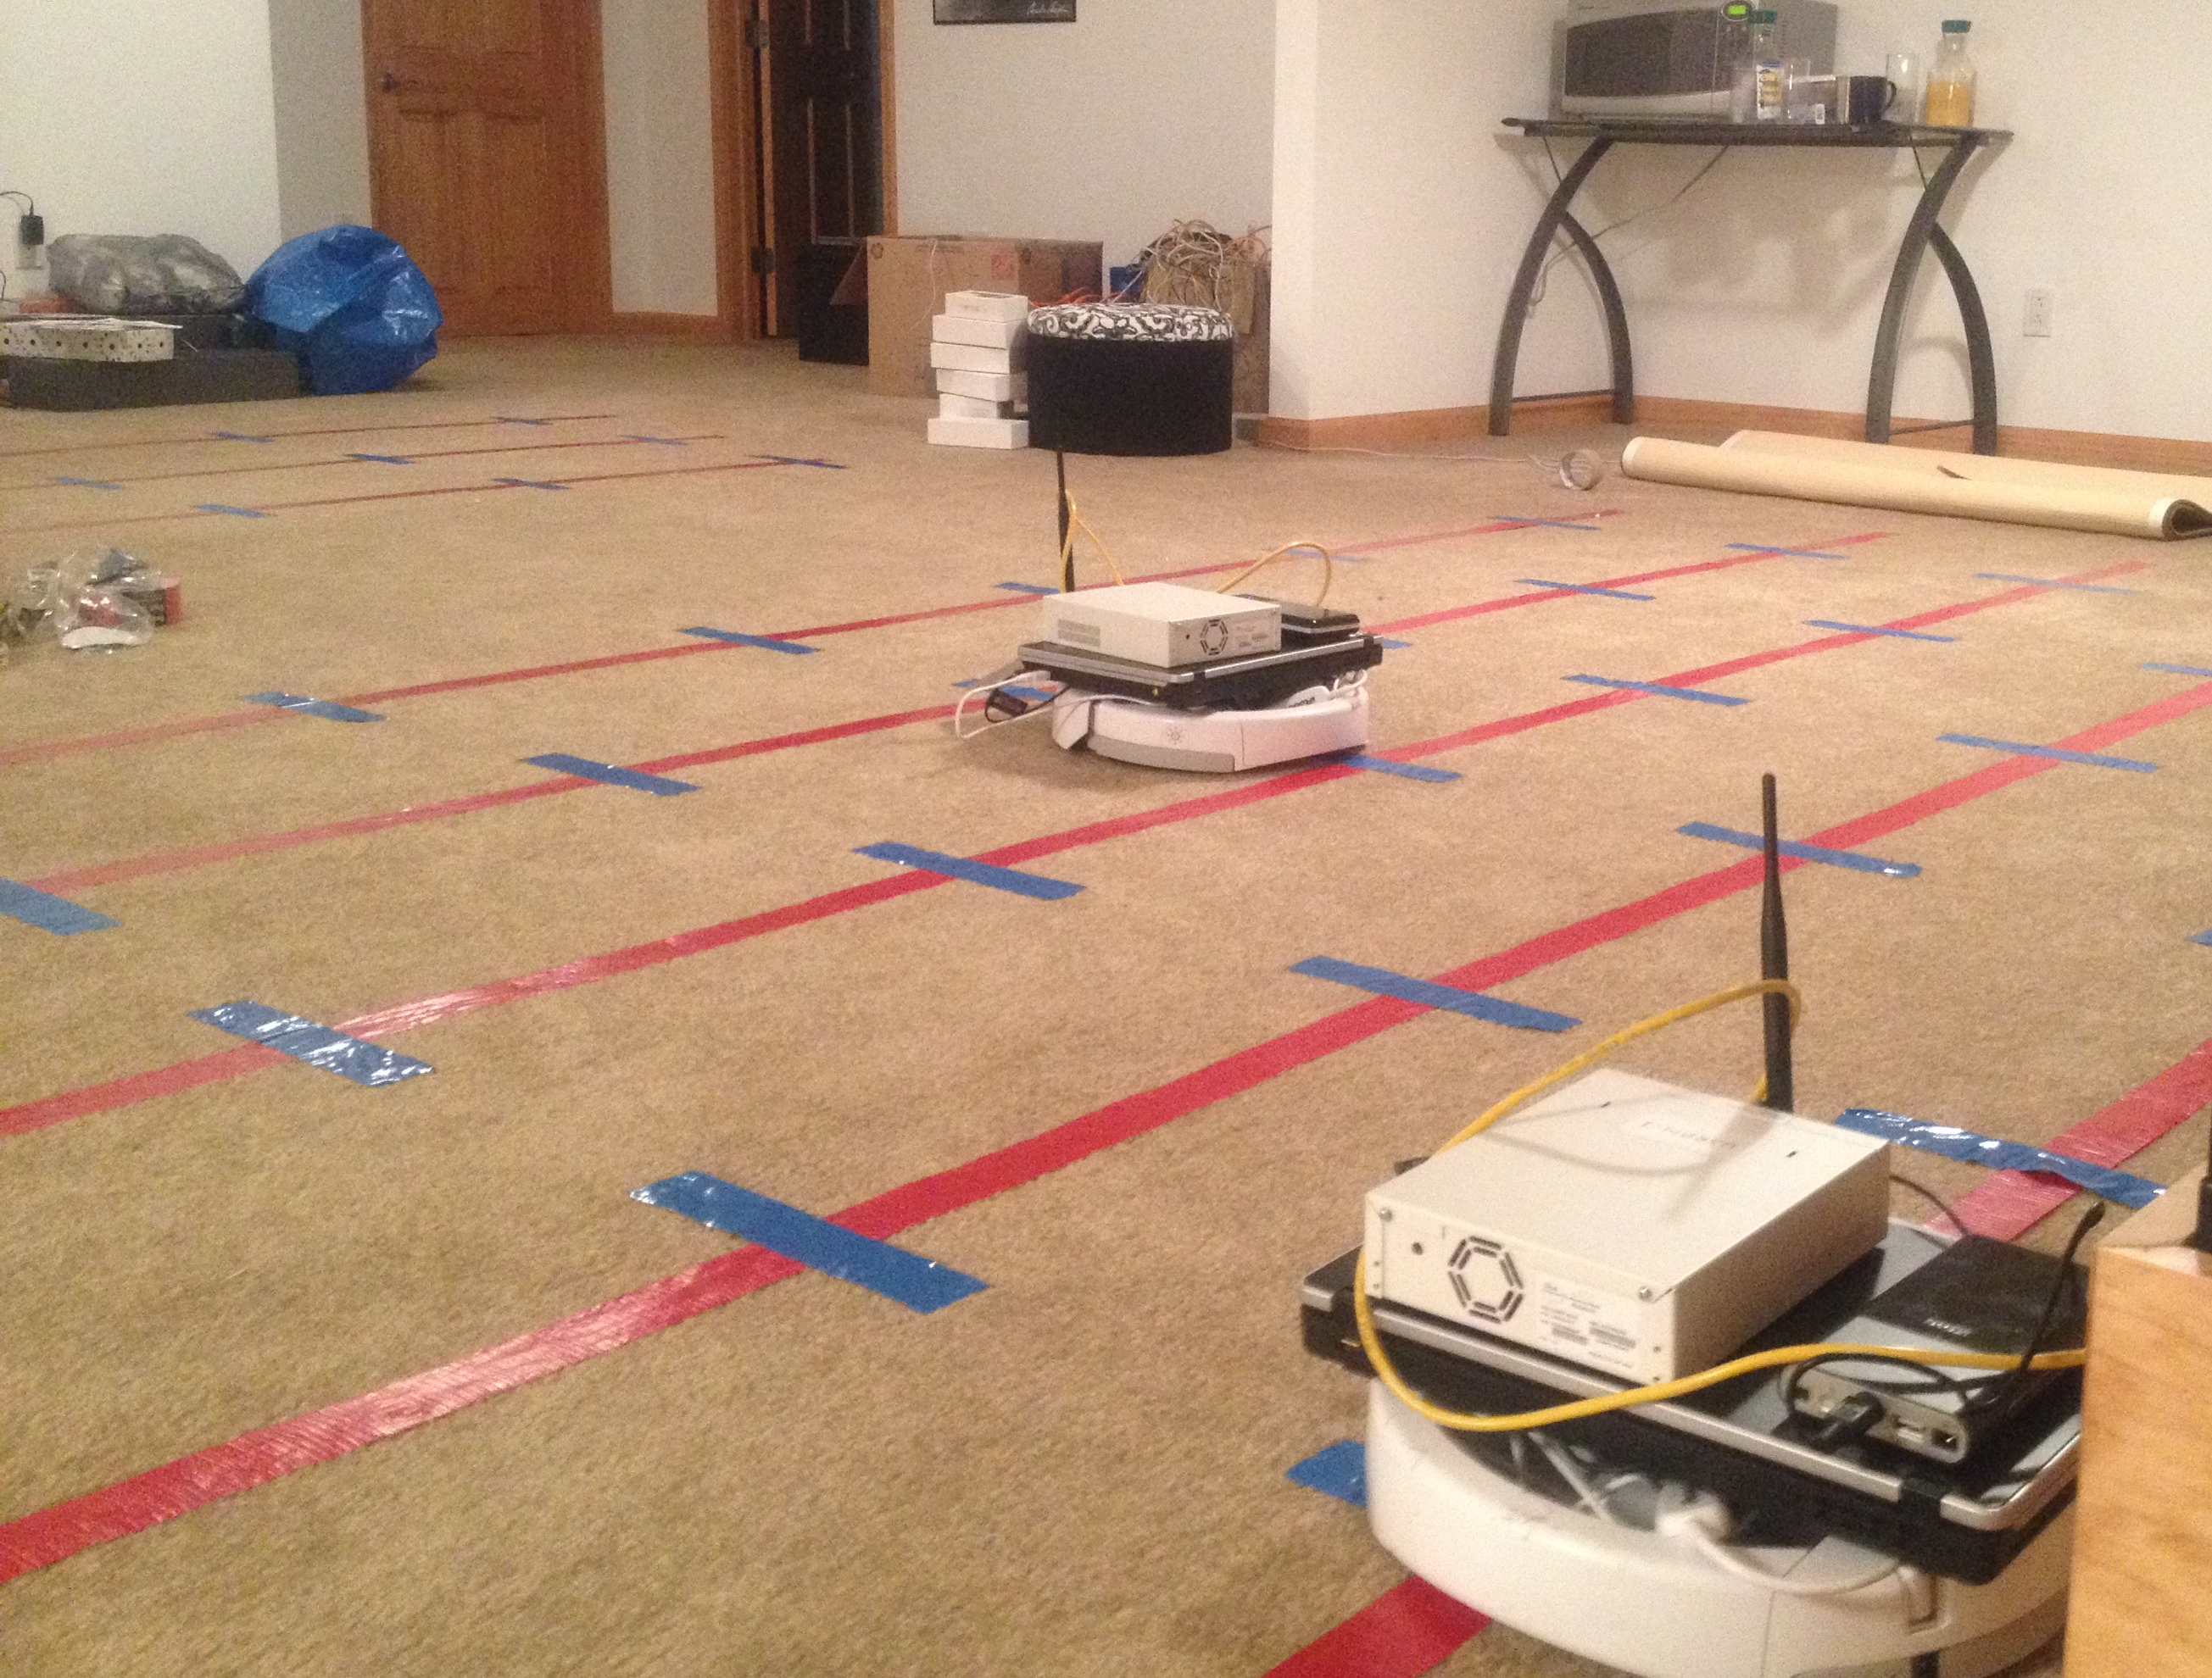
Measurements
Platform: USRPs and off-the-shelf laptops

Slide 22
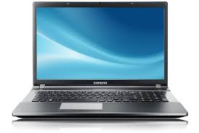

Methodology
AP Mobility Area
Client
3) MacroMobility
1 foot
Spot
Client
Three Regimes of Mobility
Client
Pixels
1) MicroMobility
2) MiniMobility
Client

Slide 23
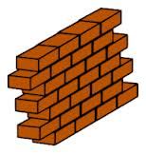


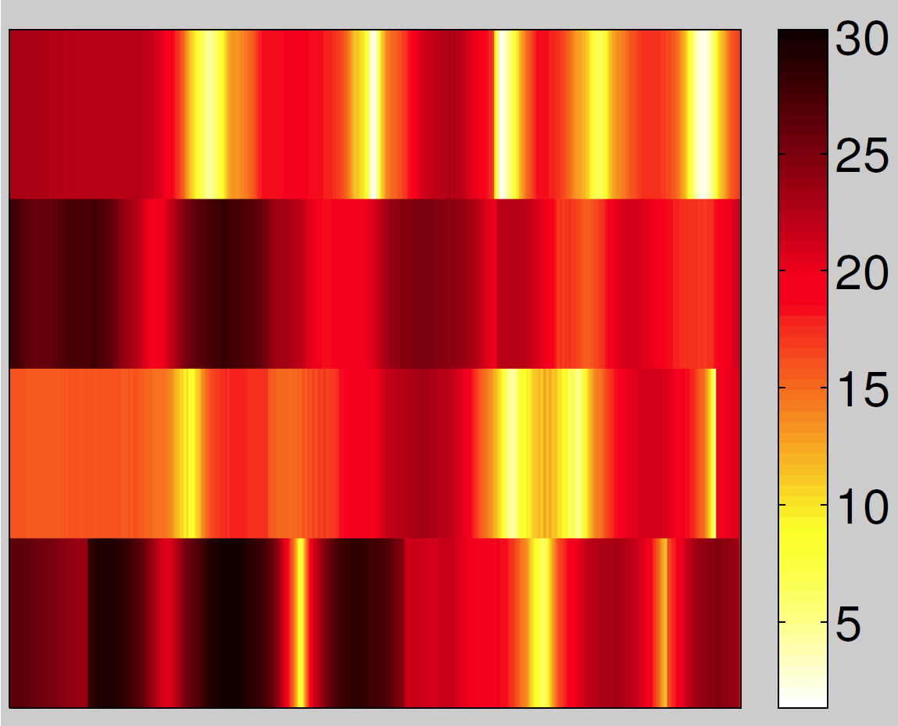

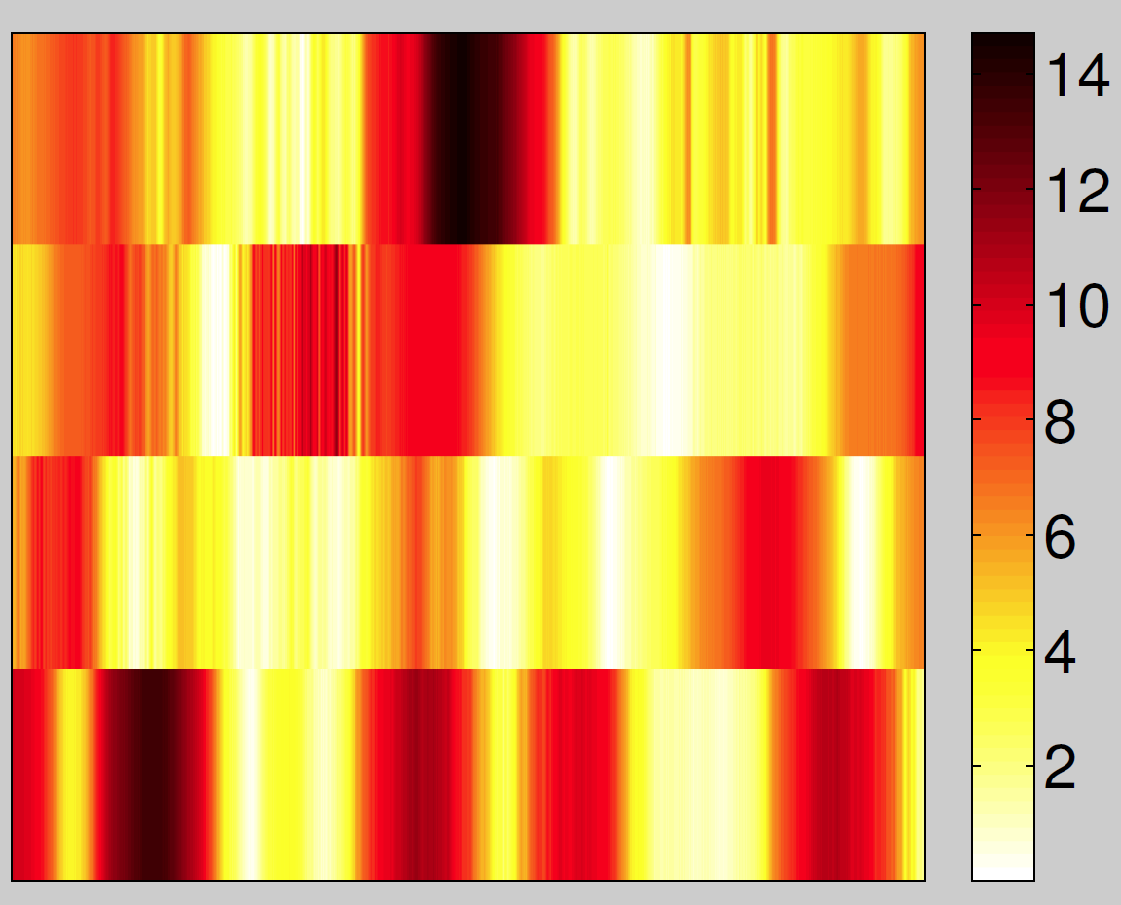
MicroMobility
Interfering (Neighbor) AP
Client
Weak Interference
Your AP
Good SNR

Slide 24
SNR Variation within a Spot
CDF of (max – median) SNR.
CDF of (median - min) SNR.

Slide 25
MicroMobility: Upper bound on Throughput Gain with Interference

Slide 26
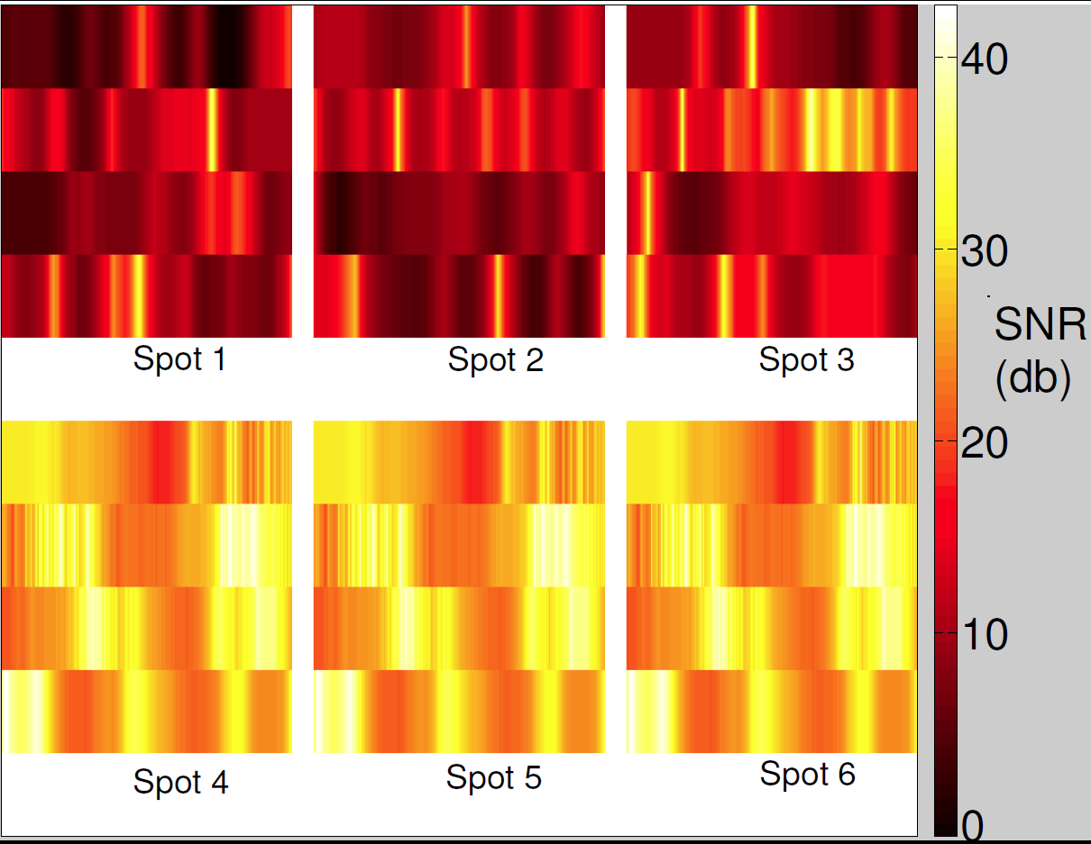
MiniMobility: SNR Variation over 6 Spots

Slide 27
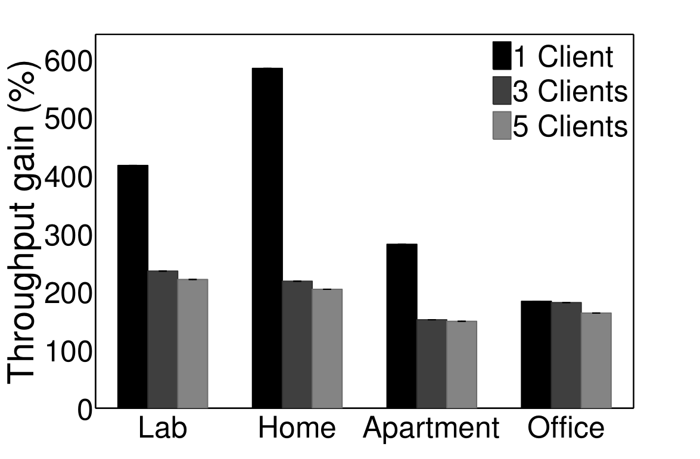
MiniMobility: Upper bound on Throughput Gain
Without interference
With interference

Slide 28
MacroMobility: Upper bound on Throughput Gain

Slide 29
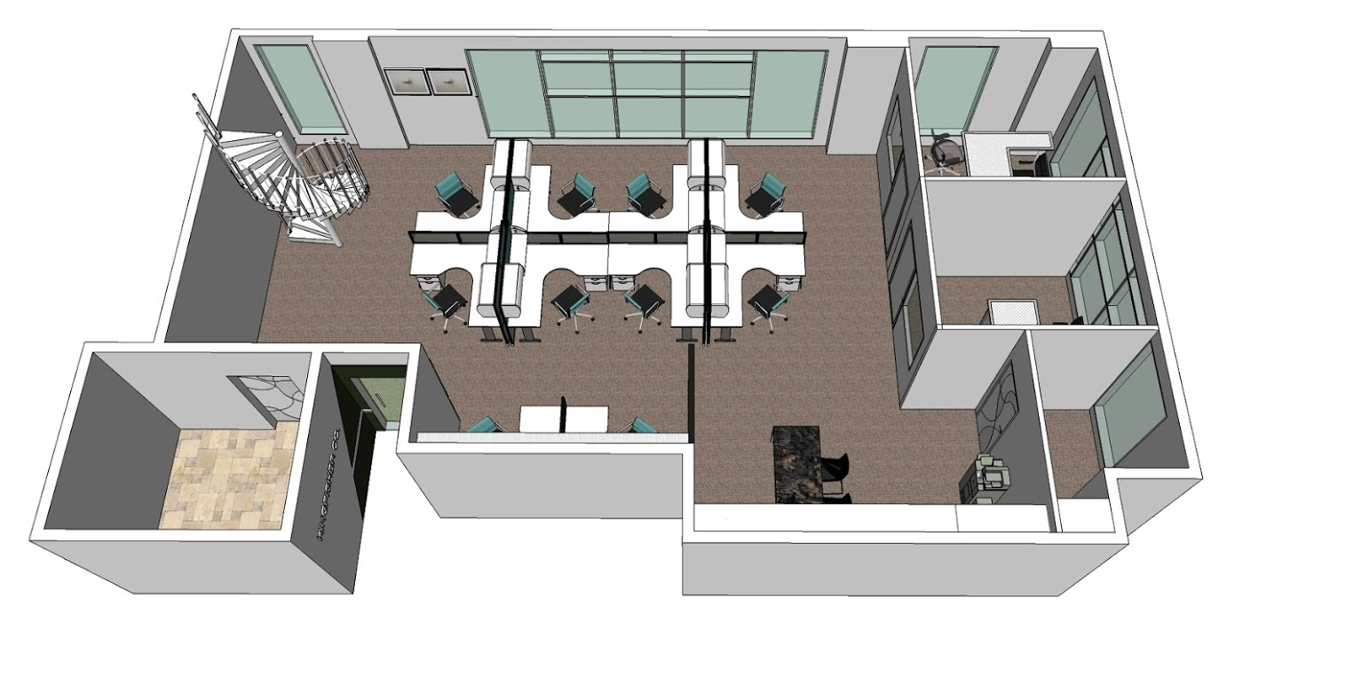
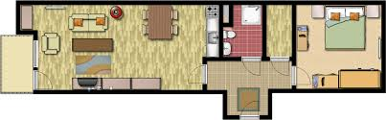
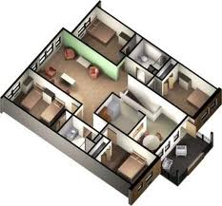
Cloud Controlled
Mobility
Coordinated Mobility

Slide 30
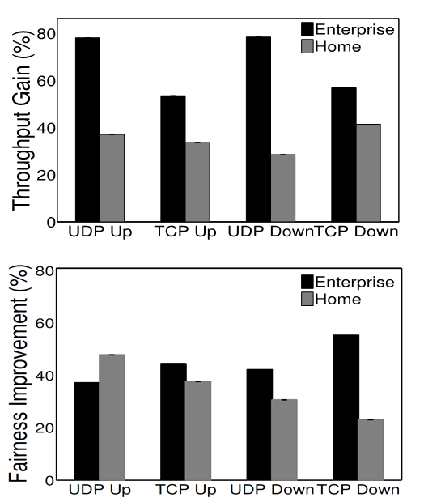
Coordinated Mobility Gains
30 Node, 6 AP testbed with measurement based simulation

Slide 31
Need not Move too much
Close by AP
Client

Slide 32
Need not Move too much
Pixels of comparable SNRs connected with a line.
Far away pixels, chosen carefully, offer strong SNRs

Slide 33
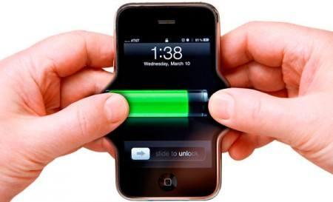


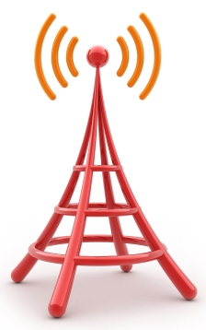
Many More Opportunities
Energy savings
Due to greater data rates, fewer re-transmissions
Range finding possible via careful antenna motion
Averages out multi-path
More bits of secret keys from the channel
Through frequent antenna mobility
Quadcopter based cell tower extension
Possible to avoid shadow regions
Channel quality at heights different from ground

Slide 34
Many Challenges too
How to relocate to the right pixel for improved SNR?
When to relocate?
Joint mobility and power control, channel management
Optimizing for multiple clients. New scheduling schemes
Mobility planning in between protocol idle periods
Leverage overheard transmissions for mobility decisions
Improved multi-AP coordination
Many others …

Slide 35
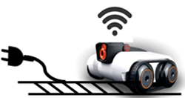

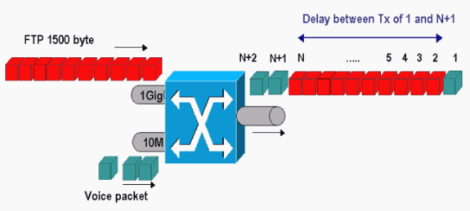
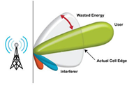
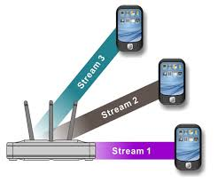

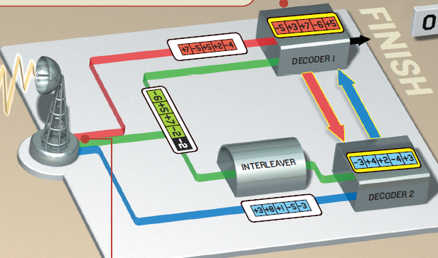
Take Away
Infrastructure
Mobility
Power Control
Scheduling
Beamforming
Channel Selection
MIMO
Coding
35

Slide 36
Thank You! Questions?
Mahanth Gowda
gowda2@illinois.edu
Systems and Networking Research Group (SyNRG)
http://www.synrg.csl.illinois.edu

